Slide 1
ONLINE MUSIC LIBRARY WITH MUSIC PLAYER
Presented by
Sourabh s. Khaire
Vinay chhapre

Slide 2
Introduction
The main objective of developing this online web application, is to collect different MP3 songs of different categories and make a music library in one place where users can play and listen the latest songs at free of cost. This application also include a music Player to pick and play the songs from music library.
The design of this application mainly realizes three core functions including main play interface, menus (artist, album, all songs etc.) and song search.

Slide 3
Existing System
User can even directly download the music files instead of listening it.
Downloading the music file require time and storage page.
It’s also creating case of piracy, as user can download file and can create his/her own website.

Slide 4
PROPOSED SYSTEM MODULES
This project “ONLINE MUSIC LIBRARY WITH MUSIC PLAYER” is divided into following modules.
Admin: -
Admin (developer of this application) will collect all the Data for this application like Songs Names, Film/Album Names, Other metadata, and Play Link & Store in Data Base
Main Interface: -
Main interface implements all the basic commands for playback control like play, pause, stop, previous, next and volume control. It provides facilities to open previously saved play lists, show play list manager.
Arranging all songs in three different categories that are Albums, Artist, and All Songs, where all three categories will sorted in alphabetical order.
Searching songs by accepting a keywords in searched bar.

Slide 5
Hardware & Software requirement Specifications
Hardware requirements
Monitor : CRT or LCD monitor
Keyboard : Normal or Multimedia
Mouse : Compatible mouse
Software requirements
User Interface Design : HTML, JavaScript, AJAX, JQuery, Bootstrap
Language Used : PHP
Tools : Wamp Server
Database Server : MySQL
Web Browser : Mozilla, Google Chrome, IE10, OPERA

Slide 6
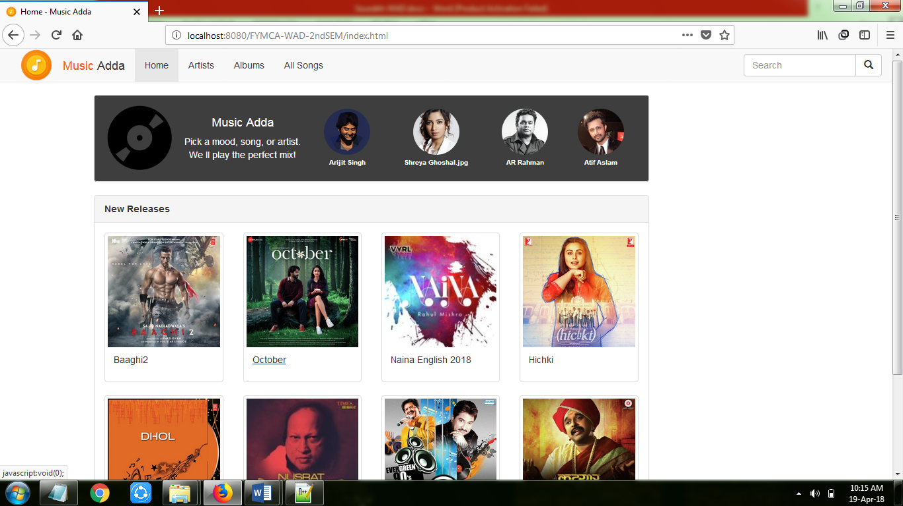
Working
Index.html
album.php

Slide 7
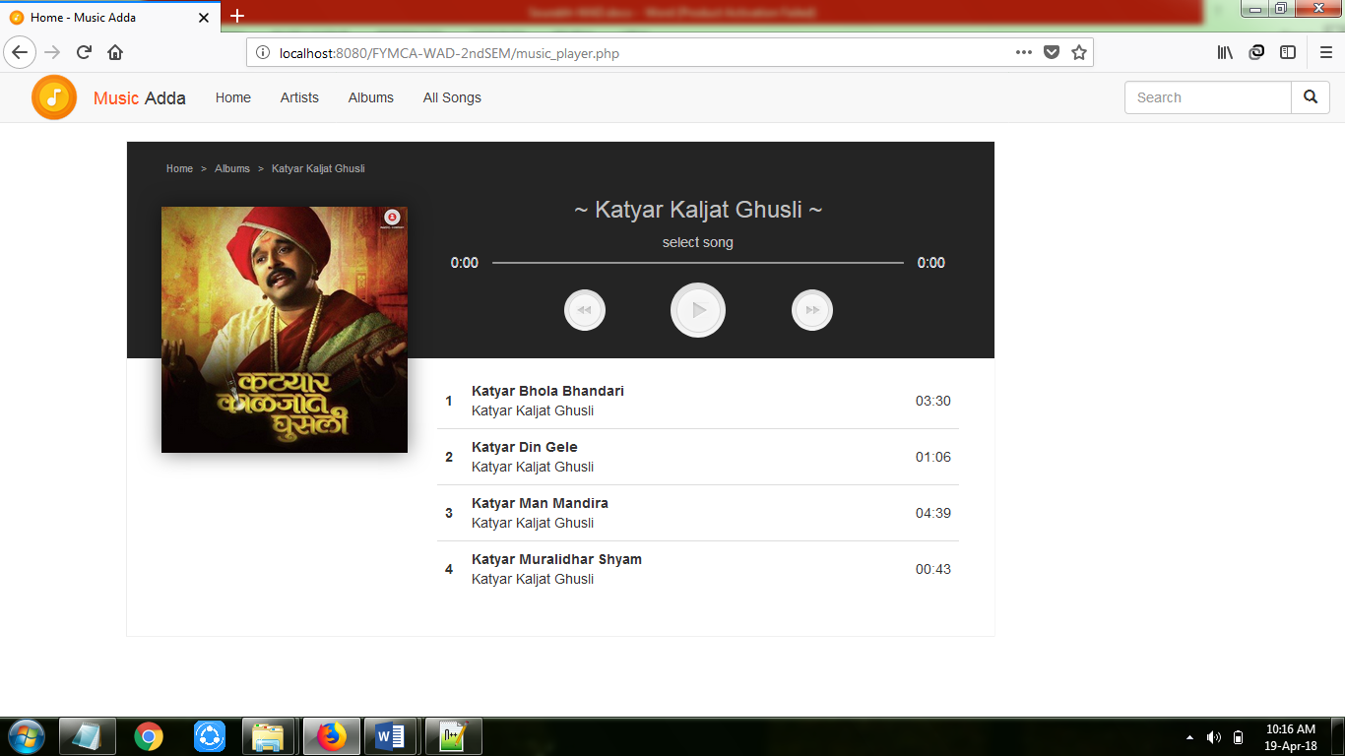
Working

Slide 8
Working
How music player is working:
1. With the help to sciprting i.e. using javascript & php this application fetch all songs from database and create a array of song.
2. This array is dynamic in nature that create maximum allocation space for storing all songs.
3. This array maintain index value for each and every song in list starting from i=1 till total size of array.
4. Therefore this application create a queue of song with the array.
Selecting song and playing that song:
1. To play any song this application pass an index value in function i.e. play_song(var index);
2. Now this function change src value of audio player
i.e. audio.src = array[index];

Slide 9
Working
Fowarding in music player:
1. For forwarding song in this application music player invokes forward function i.e. forwordsong();
2. Now function check following condition to forward the songs.
if(current_position >=max_length_array){
current_position = 1;
}
else {
current_position++;
}
3. After applying above condition this function call again play_song function by passing index as current position for playing next song.
play_song(current_position);

Slide 10
Working
Rewinding in music player:
1. For rewinding song in this application music player invokes rewind function i.e. rewindsong();
2. Now function check following condition to forward the songs.
if(current_position == 1){
current_position = max_length_array;
}
else {
current_position++;
}
3. After applying above condition this function call again play_song function by passing index as current position for playing next song.
play_song(current_position);

Slide 11
Limitations
If Internet connection is slow it becomes difficult to fetch data from the database and execute the query.
Server Problems.
User cannot increase or decrease volume of music player.
User can only able to play available song in database.
User cannot play his/her own on this application.

Slide 12
Goals Achieved
Reduced downloading effort. Reduced the speed require for downloading.
Portable and flexible for further enhancement.
Web enabled.
Help to reduce piracy, that user not able to download any song and create their own website.

Slide 13
THANK YOU

